Slide 1

Testing with Jest

Slide 2

The Testing Formula
Arrange
Set Everything Up
Act
Do the thing you are testing
Assert
Make sure it acted as expected
Notes:
Arrange is generally the most complex part of the test

Slide 3
Jest Test function
Tests in jest are a function call
test(“”, () => {} )
Pass in two arguments:
Name of Test
Function to execute

Slide 4
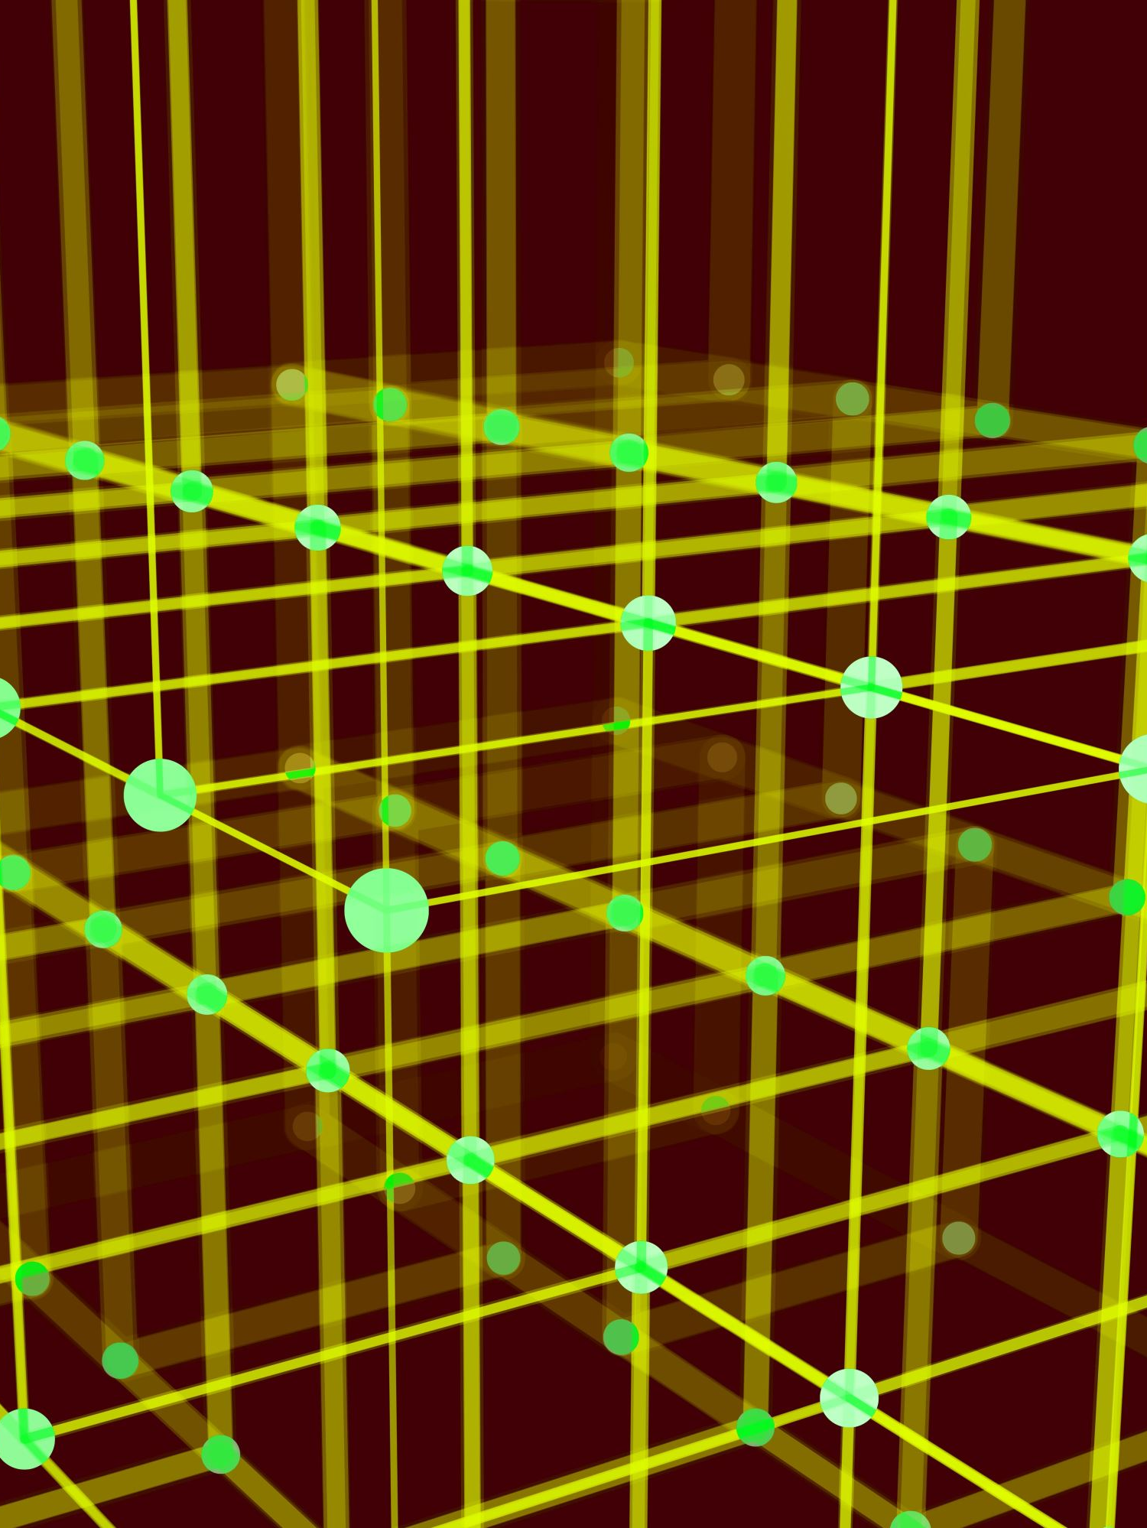
Render function
Allows us to render the component we are testing
render(<Component />)
Notes:
ARRANGE

Slide 5
UserEvent
Lets us simulate user events during a test
Click is all we will be using for now
Pass in target for event
To Install
npm install @testing-library/user-event
.click()
.dblClick()
.hover()
Etc…
Notes:
ACT

Slide 6
Expect
Jest uses expect
expect(variable).toBe(expectedResult)
Matchers
.toBe()
.toBeGreaterThan()
.toStrcitEqual()
.toContain()
.toBeTruthy()
.toBeNull()
…
Notes:
ASSERT

Slide 7

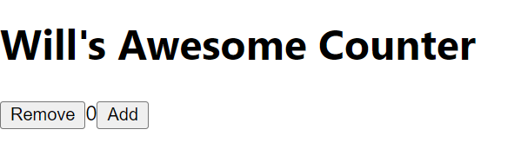
Walkthrough: TDD Counter Kata
Use TDD to create a counter component
Should have a title
Should have a default initial value of 0
Should increase by 1 when add is pressed
Should decrease by 1 when remove is pressed
Count should not go below Zero
Notes:
To run tests:
>npm test

